Slide 1
Kiss vs Kiss
Group 8 project presentation, on our site “www.ULFencing.ie” Jack Griffith, Elin Smaros, Kieran Ryan

Slide 2
Introduction & Overview
Kirean Section - Normalisation - Elin Section - Footer -

Slide 3
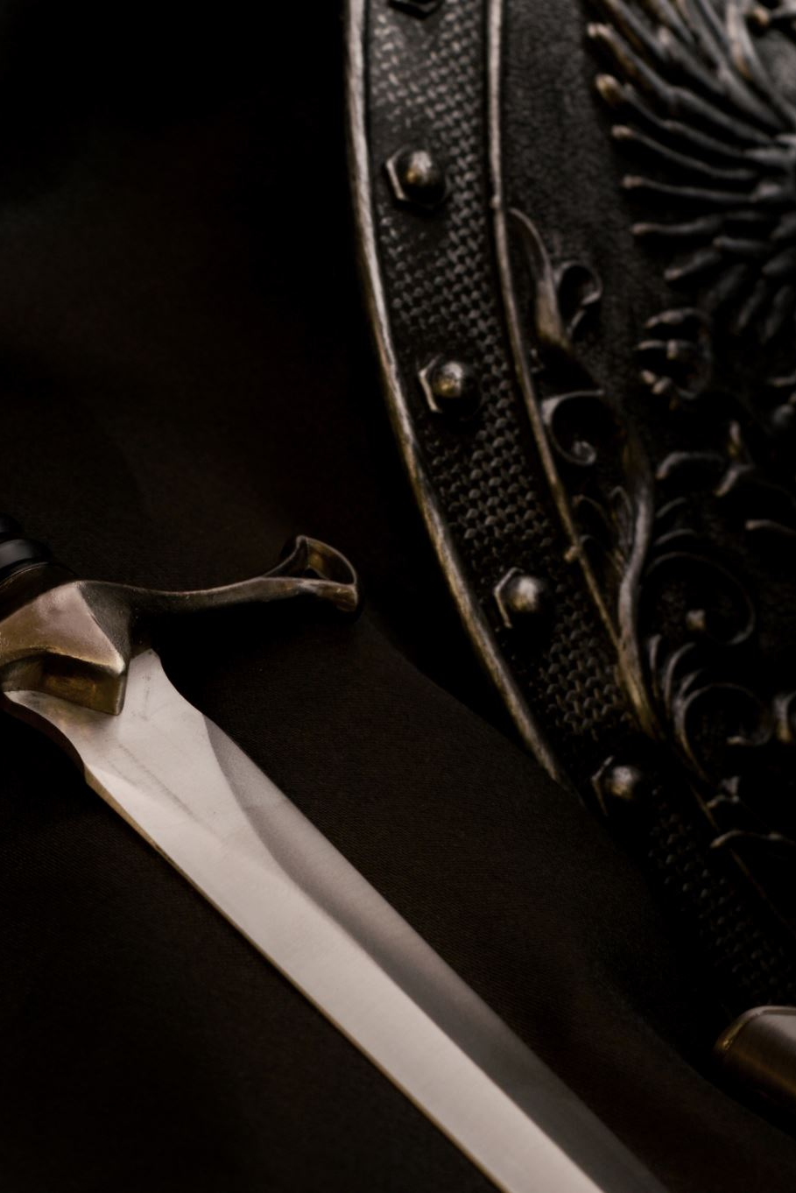
It started with a broken Sword
- Started with broken swords as first data point - Expansion, other things we considered putting in list - Normalisation

Slide 4
What we wanted and what the footer gave us
- Original design plan - Colour change - Footer issues

Slide 5
Jack’s PHP adventures
- Issues with php code - Design back and fourth supplement vs replacement - We didn’t have a git clash - Over engineering (Sql insert count idea)

Slide 6
Questions

Slide 7
Bye

